Slide 1
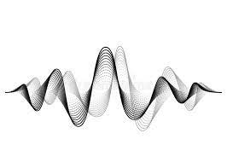

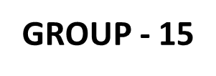
INDIAN INSTITUTE OF TECHNOLOGY GUWAHATI
Mechanical vibration PROJECT
MODAL ANALYSIS OF A THIN PLATE AND ITS STRUCTURAL MODIFICATION FOR THE APPLICATION IN AEROSPACE SYSTEM.
Submitted by :- SINGH ABHISHEK RANJAN – IMDAD HUSSAIN – ROHIT RAMAKANT KADAM

Slide 2
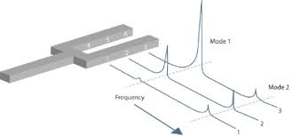

WHAT IS MODAL ANALYSIS ?
Modal Analysis is the process of determining inherent dynamic characteristics of a system.
Mode Shapes – It is a deflection pattern related to a particular natural frequency and represents the relative displacement of all parts of a system for that particular mode.
Plate – It is a 2-Dimensional sheet of elastic material which lies in a plane. A plate is considered thin if the thickness of the plate is less than $\frac{1}{10}$ the minimum lateral plate dimension.

Slide 3
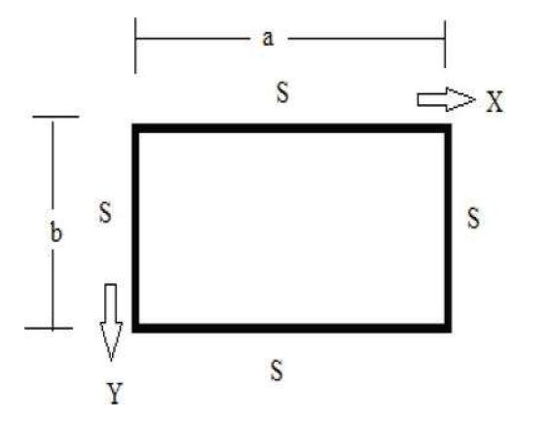
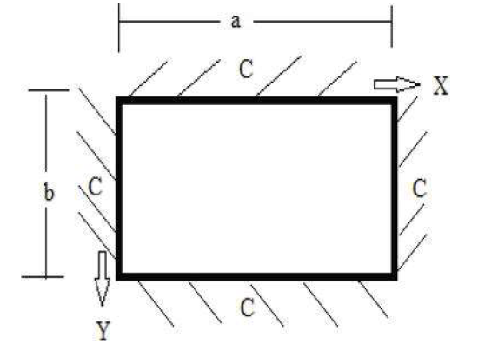
FORMULATION
We have considered a plate of length ‘a’ , width ‘b’ , and thickness ‘h’ , having Young’s modulus of elasticity ‘E’ , Poisson's ratio ‘ν’ , and mass density ‘ρ’.
Also, we have considered two cases of simply supported-simply supported (SS-SS) and clamped-clamped: clamped-clamped (CC-CC) boundary conditions for the plates in the xy-plane.
Fig 2 :- CC-CC plate
Fig 1 :- SS-SS plate

Slide 4
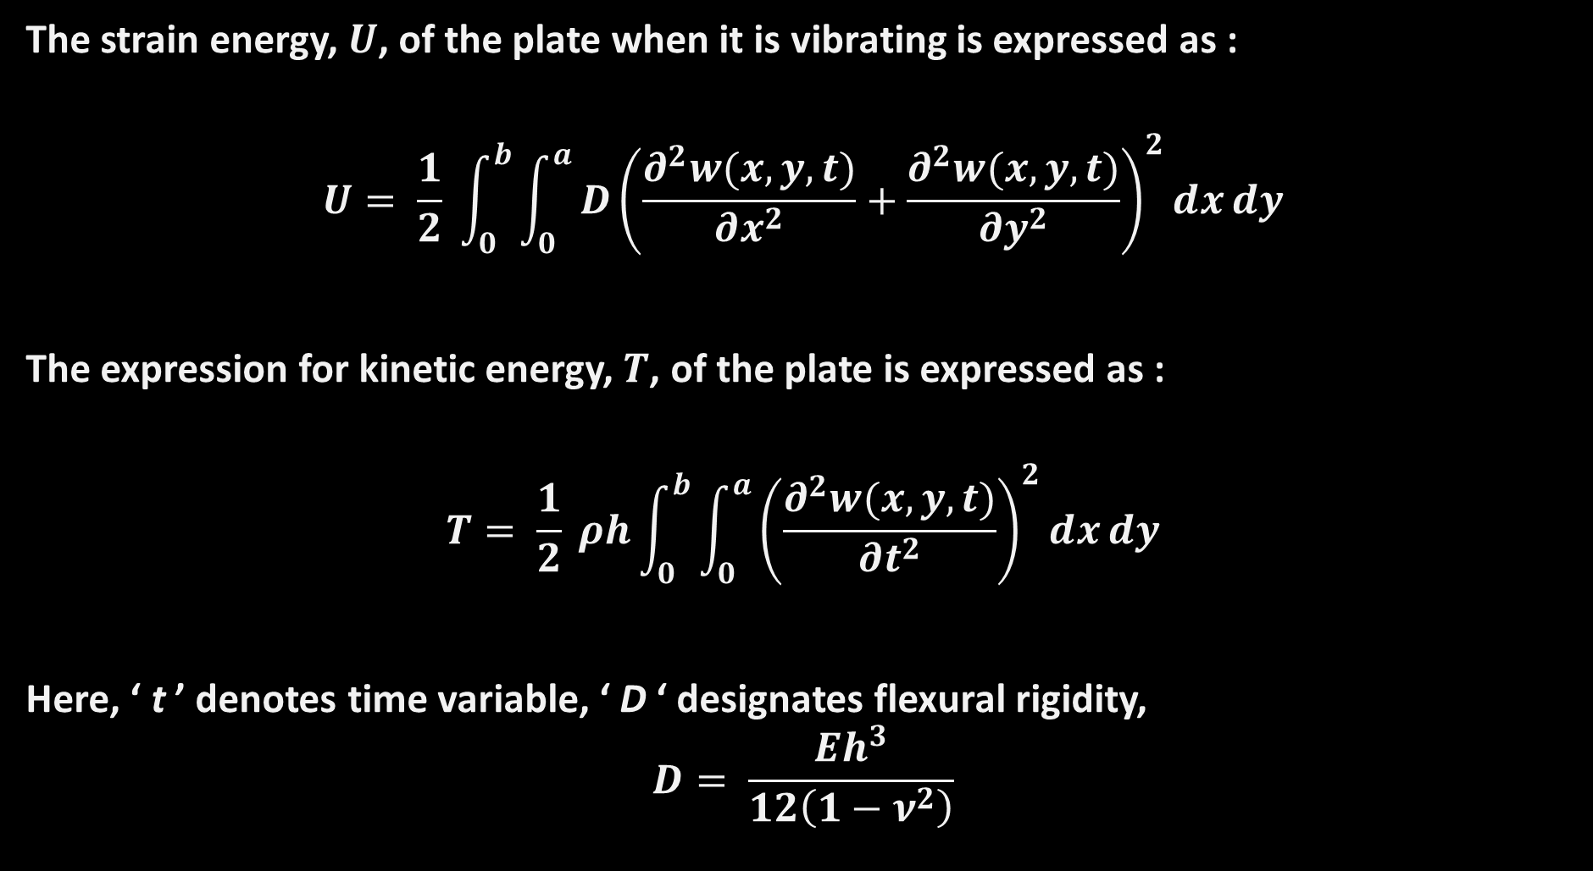
The strain energy, $U$, of the plate when it is vibrating is expressed as :
$$U= \frac{1}{2} \int_{0}^{b}{\int_{0}^{a}{D{\left(\frac{∂^{2}w(x,y,t)}{∂x^{2}}+\frac{∂^{2}w(x,y,t)}{∂y^{2}}\right)}^{2}ⅆxⅆy}}$$
The expression for kinetic energy, $T$, of the plate is expressed as :
$$T= \frac{1}{2} ρh\int_{0}^{b}{\int_{0}^{a}{{\left(\frac{∂^{2}w(x,y,t)}{∂t^{2}}\right)}^{2}ⅆxⅆy}}$$
Here, ‘ t ’ denotes time variable, ‘ D ‘ designates flexural rigidity,
$$D= \frac{Eh^{3}}{12\left(1−ν^{2}\right)}$$

Slide 5
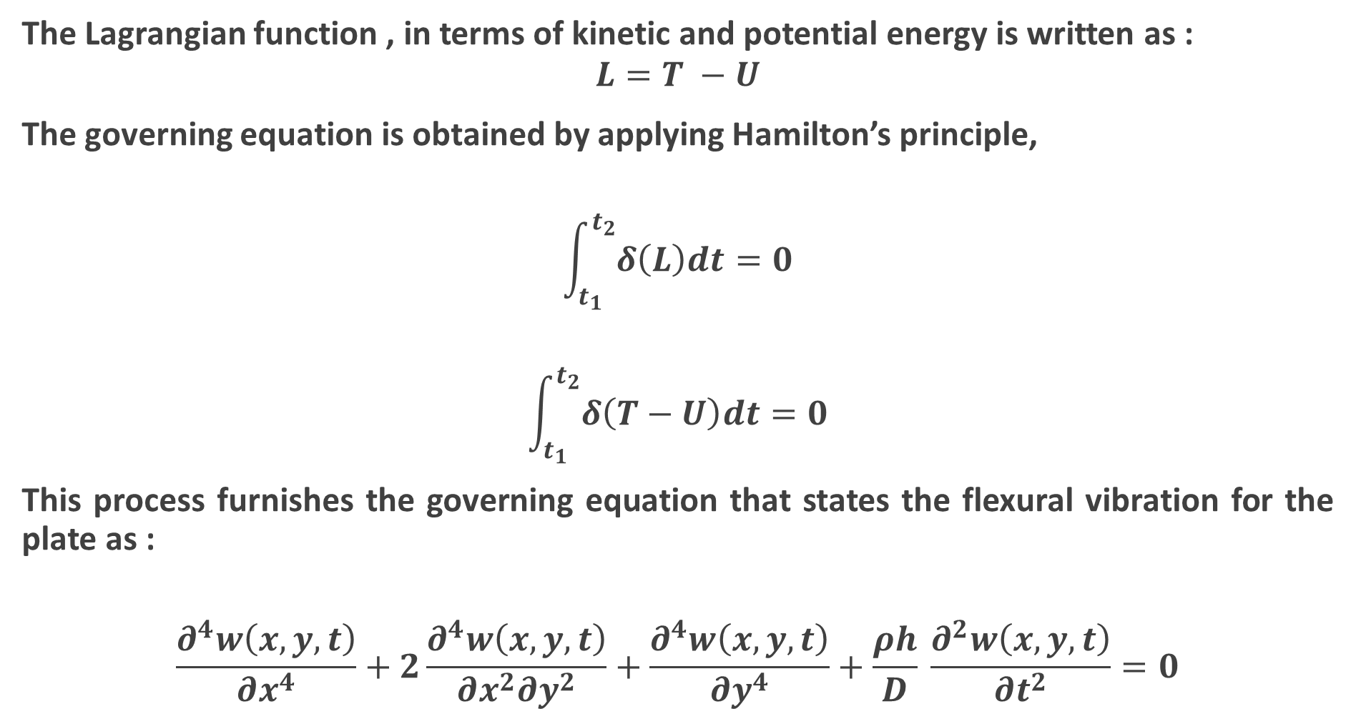
The Lagrangian function , in terms of kinetic and potential energy is written as :
$$L=T −U$$
The governing equation is obtained by applying Hamilton’s principle,
$$\int_{t_{1}}^{t_{2}}{δ\left(L\right)dt=0}$$
$$\int_{t_{1}}^{t_{2}}{δ\left(T−U\right)dt=0}$$
This process furnishes the governing equation that states the flexural vibration for the plate as :
$$\frac{∂^{4}w\left(x,y,t\right)}{∂x^{4}}+2\frac{∂^{4}w\left(x,y,t\right)}{∂x^{2}∂y^{2}}+\frac{∂^{4}w\left(x,y,t\right)}{∂y^{4}}+\frac{ρh}{D} \frac{∂^{2}w\left(x,y,t\right)}{∂t^{2}}=0$$

Slide 6

To determine the vibrational characteristic of the plate the variational method is used and the beam function is used, these functions are obtained from the solutions of the beam differential equations for various end conditions. The differential equation for a vibrating beam is written as :
$$\frac{∂^{4}w}{∂x^{4}}+α^{4}\frac{∂^{2}w}{∂t^{2}}=0$$
Solution of the above equation for the wave deformation displacement ‘ w ’ of the beam vibration can be truncated and written as :
$$w=e^{−ik_{m}x}e^{iωt}$$
Where,
$$k_{m}=\frac{πm}{a} and k_{n}=\frac{πn}{b}$$
Are used to evaluate natural frequency of the plate for the vibration parameters, m and n.

Slide 7
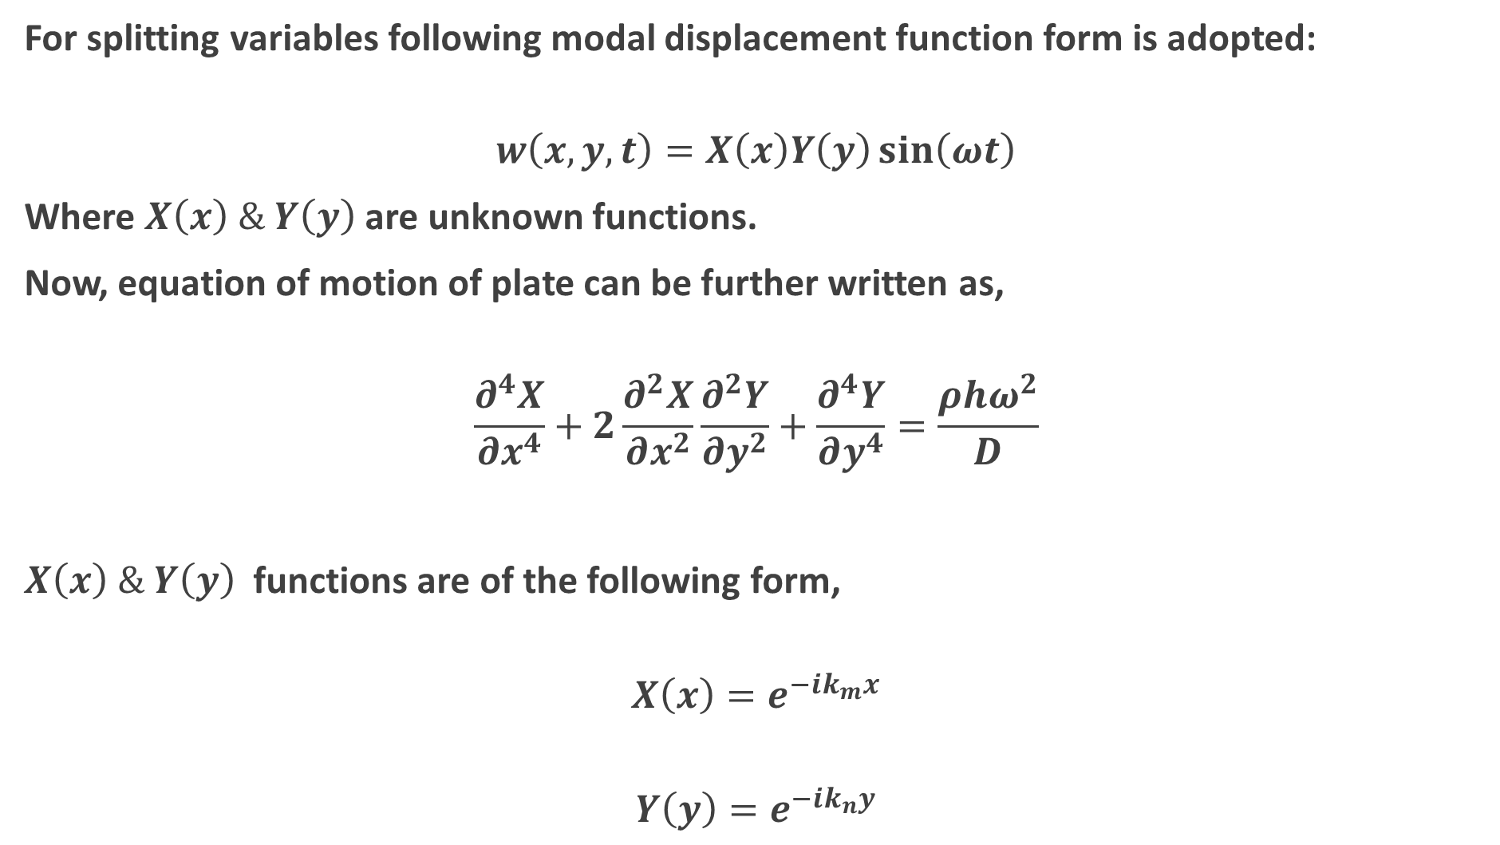
For splitting variables following modal displacement function form is adopted:
$$w\left(x,y,t\right)=X\left(x\right)Y\left(y\right)\sin\left(ωt\right)$$
Where $X\left(x\right) \& Y\left(y\right)$ are unknown functions.
Now, equation of motion of plate can be further written as,
$$\frac{∂^{4}X}{∂x^{4}}+2\frac{∂^{2}X}{∂x^{2}}\frac{∂^{2}Y}{∂y^{2}}+\frac{∂^{4}Y}{∂y^{4}}=\frac{ρhω^{2}}{D}$$
$X\left(x\right) \& Y\left(y\right)$ functions are of the following form,
$$X\left(x\right)=e^{−ik_{m}x}$$
$$Y\left(y\right)=e^{−ik_{n}y}$$

Slide 8

Further we can write,
$$\frac{∂^{4}\left(e^{−ik_{m}x}\right)}{∂x^{4}}+2\frac{∂^{2}\left(e^{−ik_{m}x}\right)}{∂x^{2}}\frac{∂^{2}\left(e^{−ik_{n}y}\right)}{∂y^{2}}+\frac{∂^{4}\left(e^{−ik_{n}y}\right)}{∂y^{4}}=\frac{ρhω^{2}}{D}$$
Or,
$$\left[k_{m}^{4}+{2k}_{m}^{2}k_{n}^{2}+k_{n}^{4}\right]=\frac{ρhω^{2}}{D}$$
Or,
$${\left[k_{m}^{2}+k_{n}^{2}\right]}^{2}=\frac{ρhω^{2}}{D}$$
Or,
$$ω=\sqrt{\frac{D}{ρh}} \left[k_{m}^{2}+k_{n}^{2}\right]$$

Slide 9
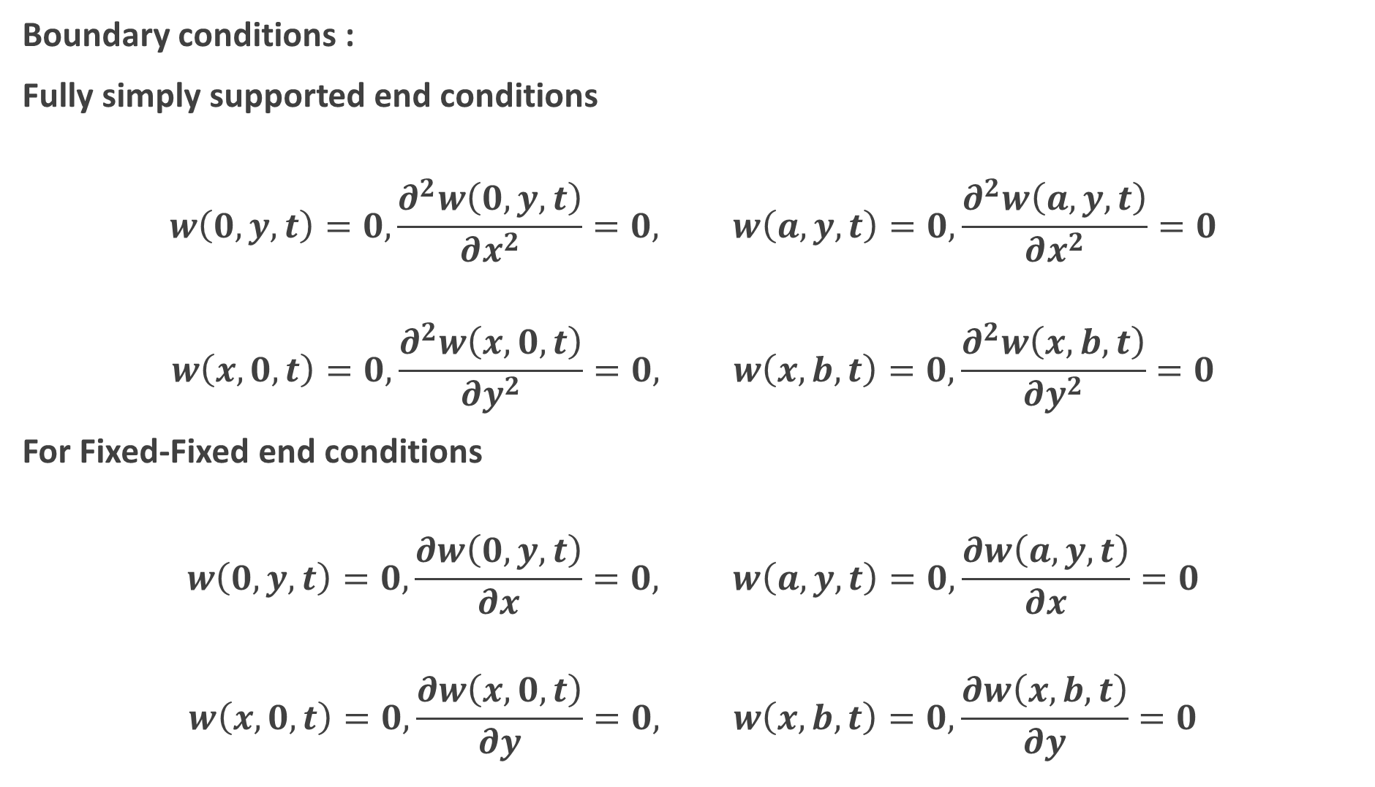
Boundary conditions :
Fully simply supported end conditions
$$w\left(0,y,t\right)=0,\frac{∂^{2}w\left(0,y,t\right)}{∂x^{2}}=0, w\left(a,y,t\right)=0,\frac{∂^{2}w\left(a,y,t\right)}{∂x^{2}}=0$$
$$w\left(x,0,t\right)=0,\frac{∂^{2}w\left(x,0,t\right)}{∂y^{2}}=0, w\left(x,b,t\right)=0,\frac{∂^{2}w\left(x,b,t\right)}{∂y^{2}}=0$$
For Fixed-Fixed end conditions
$$w\left(0,y,t\right)=0,\frac{∂w\left(0,y,t\right)}{∂x}=0, w\left(a,y,t\right)=0,\frac{∂w\left(a,y,t\right)}{∂x}=0$$
$$w\left(x,0,t\right)=0,\frac{∂w\left(x,0,t\right)}{∂y}=0, w\left(x,b,t\right)=0,\frac{∂w\left(x,b,t\right)}{∂y}=0$$

Slide 10
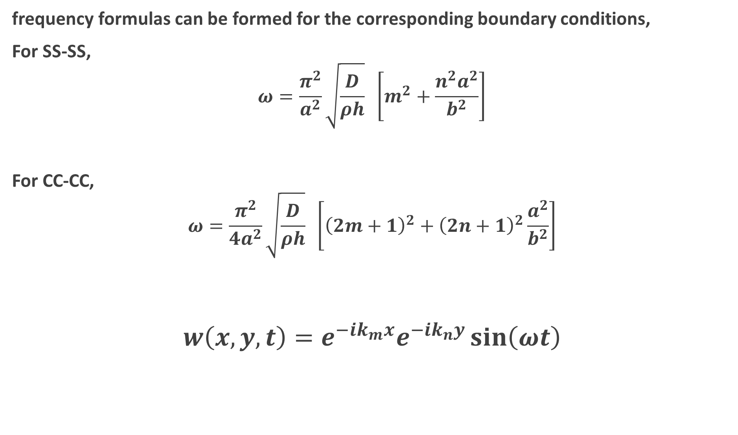
frequency formulas can be formed for the corresponding boundary conditions,
For SS-SS,
$$ω=\frac{π^{2}}{a^{2}}\sqrt{\frac{D}{ρh}} \left[m^{2}+\frac{n^{2}a^{2}}{b^{2}}\right]$$
For CC-CC,
$$ω=\frac{π^{2}}{{4a}^{2}}\sqrt{\frac{D}{ρh}} \left[{\left(2m+1\right)}^{2}+{\left(2n+1\right)}^{2}\frac{a^{2}}{b^{2}}\right]$$
$$w\left(x,y,t\right)=e^{−ik_{m}x}e^{−ik_{n}y}\sin\left(ωt\right)$$

Slide 11
DOMAIN
NUMERICAL
(NX NASTRAN)
ANALYTICAL
(MATLAB)
EXPERIMENTAL
(IMPACT TEST)

Slide 12
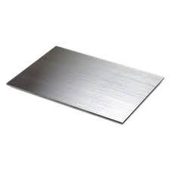
Dim: 300*300*20 mm
M= 15.50 Kg
M= 5.03 Kg
Steel
Aluminium

Slide 13
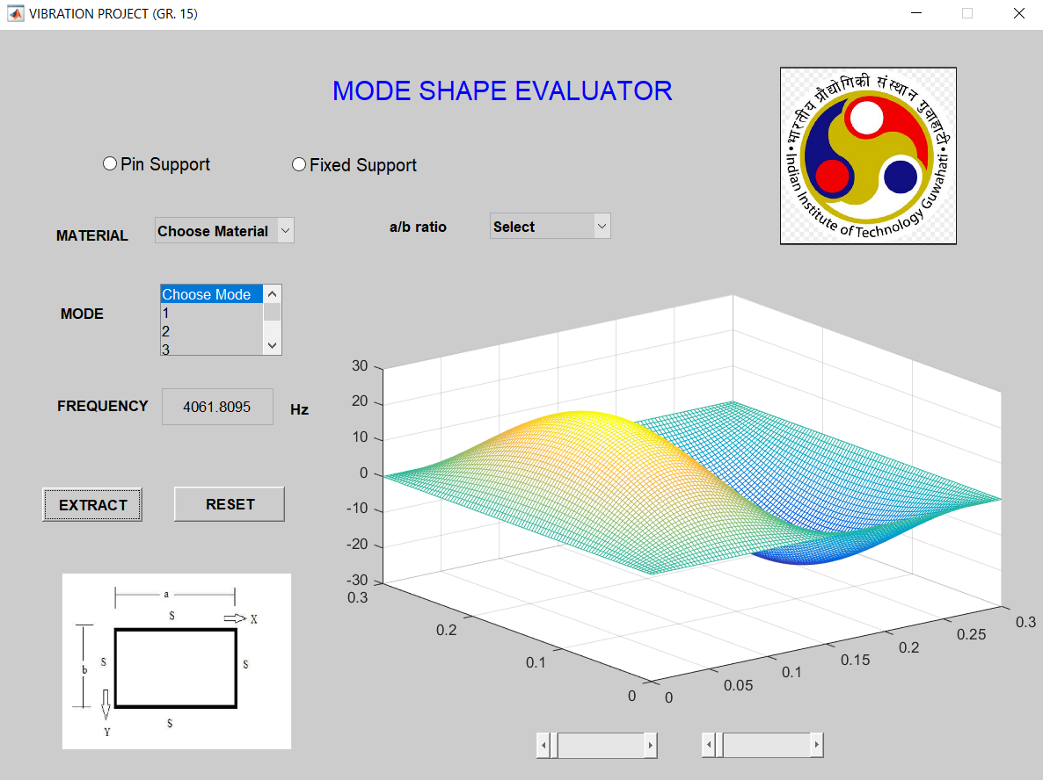
ANALYTICAL SOLUTION USING GRAPHICAL USER INTERFACE IN MATLAB
Fig 3:- GUI for analytical solutions.

Slide 14
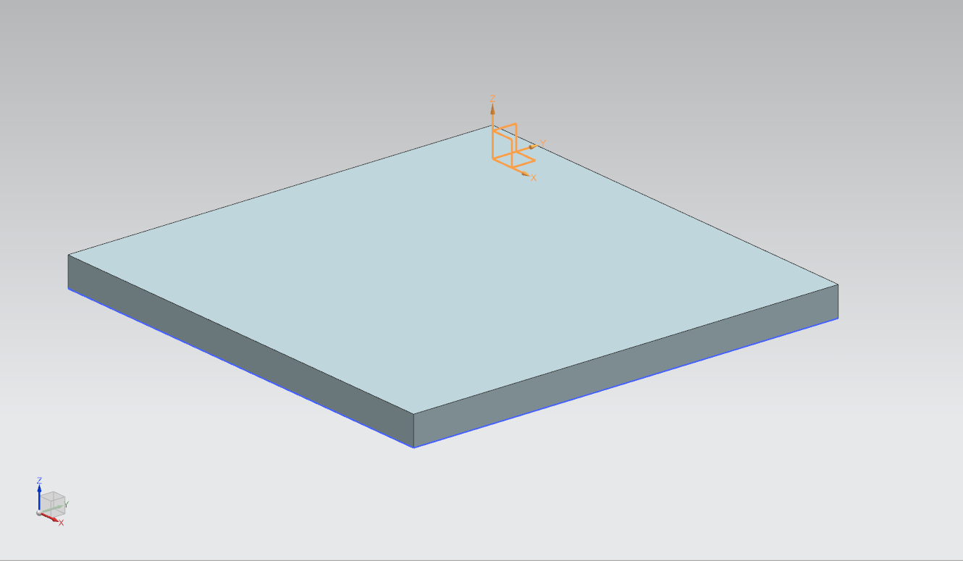
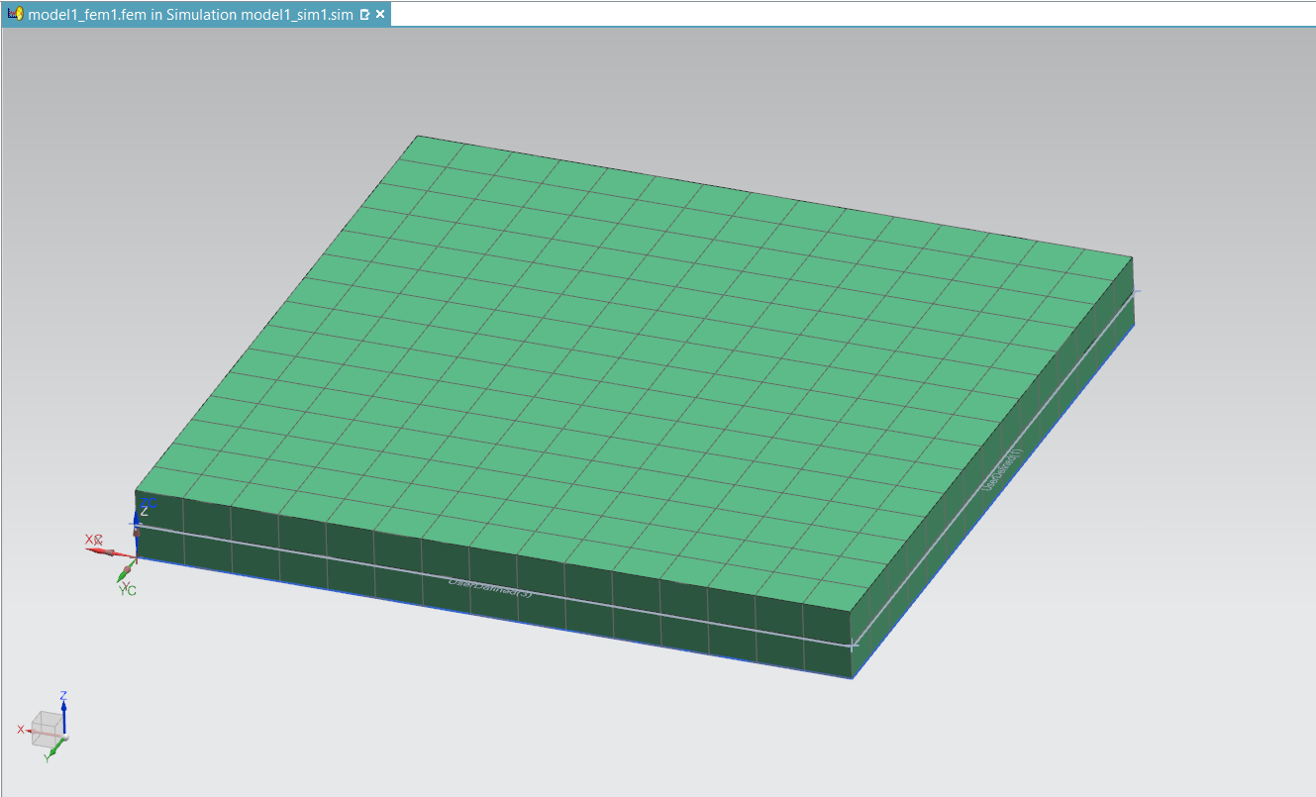
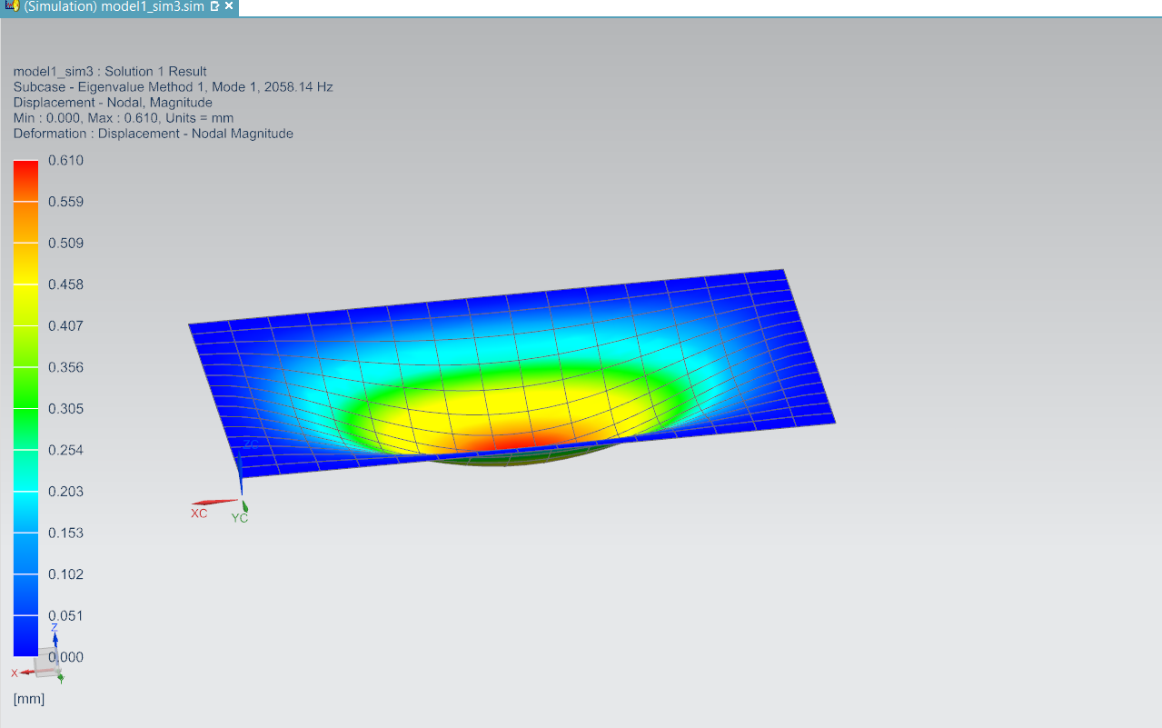
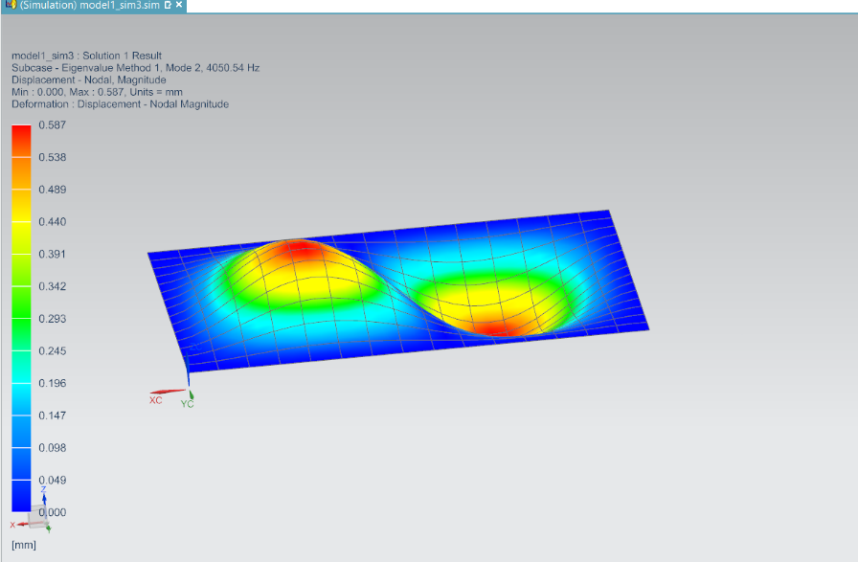
NUMERICAL SOLUTION USING FEA
Fig 4: CAD model of plate of dimension 300*300*20 mm in NX Nastran.
Fig 5: CAE model of plate with 10 mm 2D Mapped meshing size in NX Nastran
Fig 6: 1st mode shape of Thin Square plate of Steel in NX Nastran.
Fig 7: 2nd mode shape of Thin Square plate of steel in NX Nastran.

Slide 15
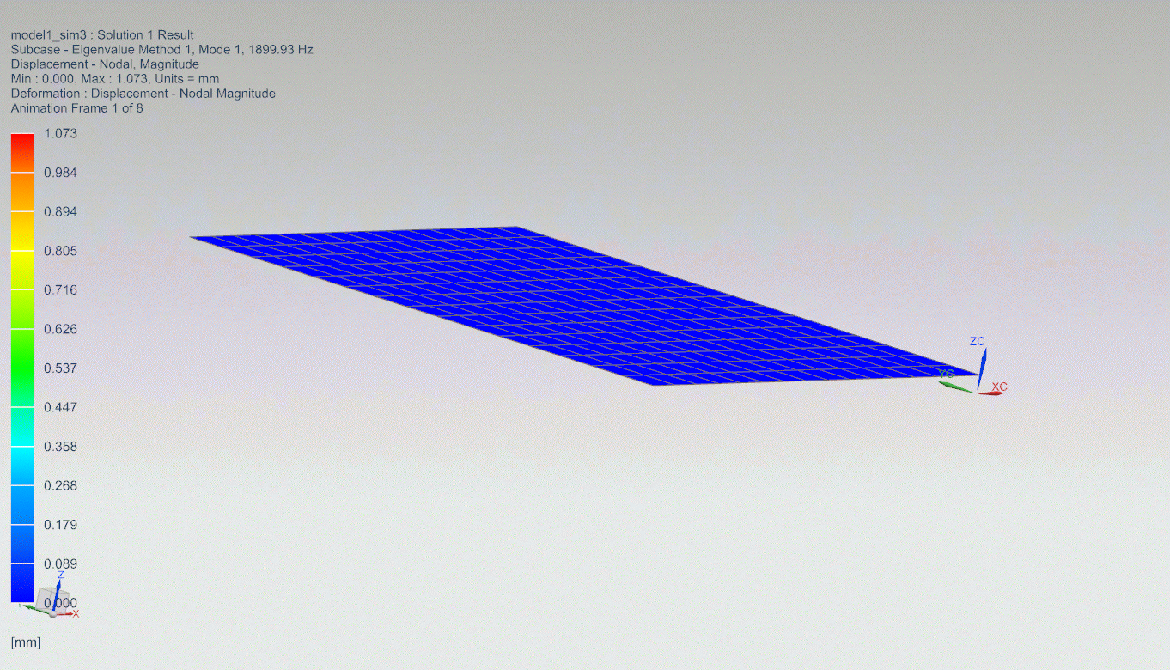
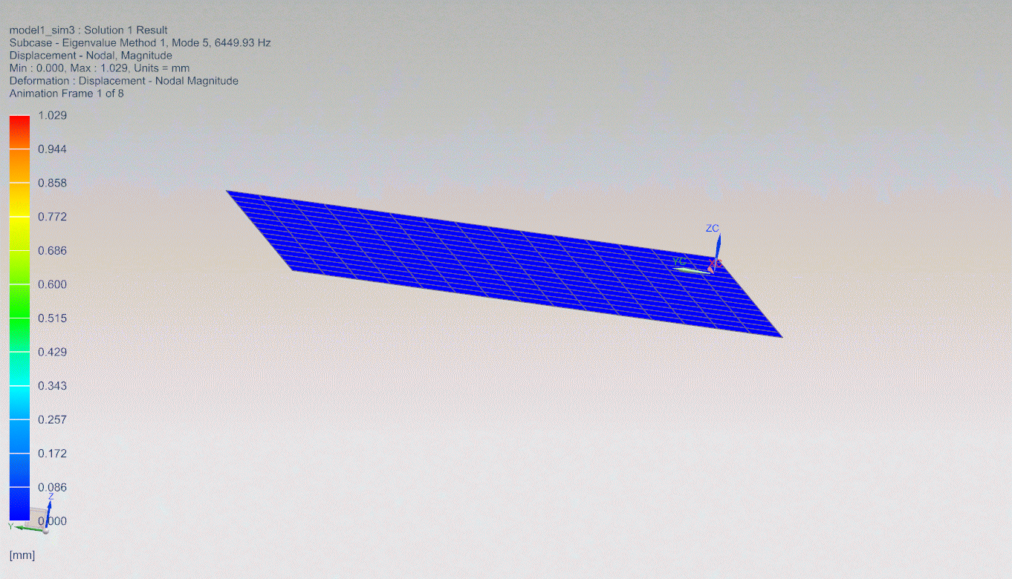
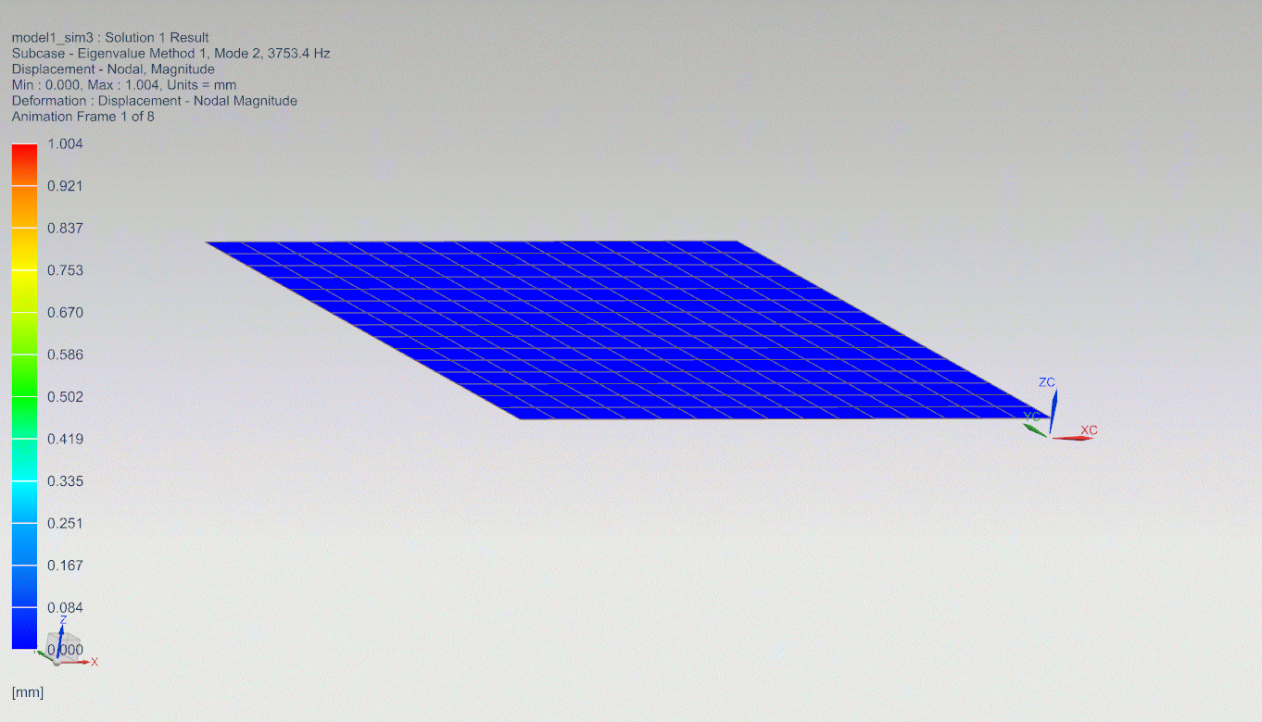
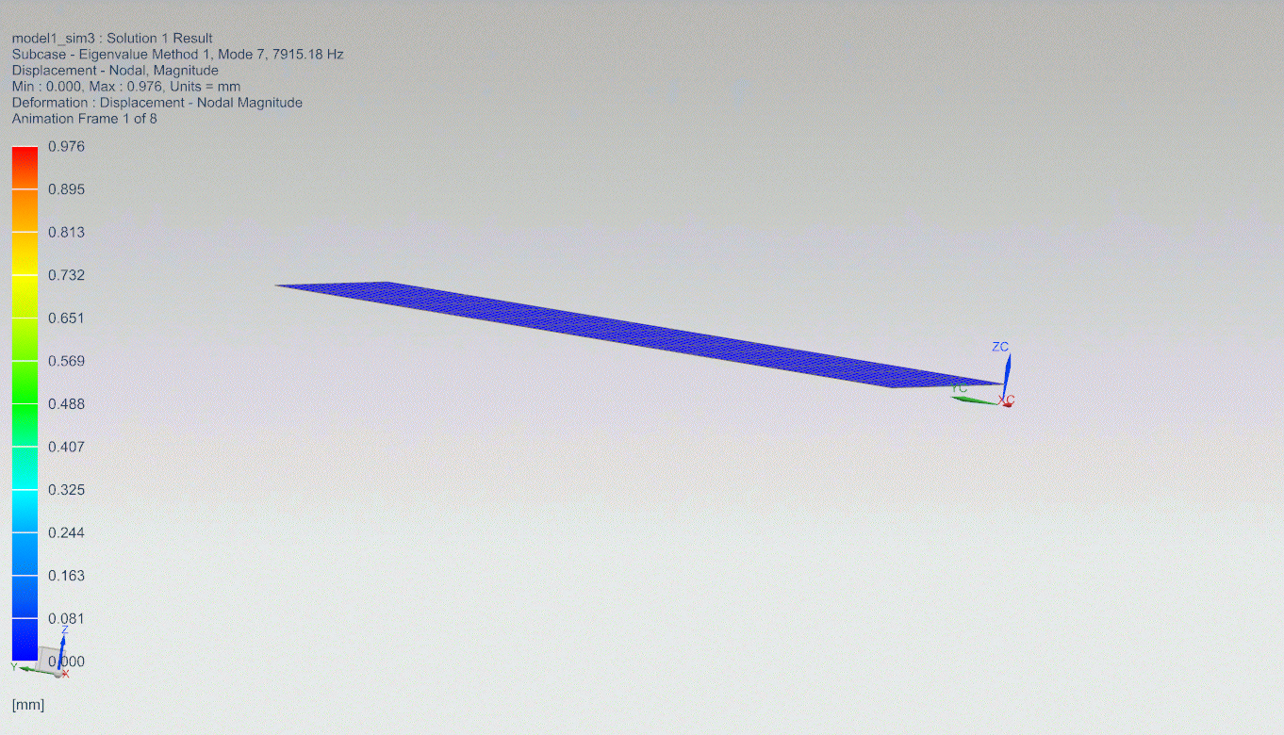
.
From left top: 1st mode, 5th mode, 2nd mode and 7th mode of vibration of aluminium plate in NX Nastran.

Slide 16
Table of frequency for material in NX Nastran For plate of 300*300*20 mm with fixed boundary condition
Mode no. | FREQUENCY in Hz
 | STEEL | ALUMINIUM
1 | 2058.14 | 1899.93
2 | 4050.54 | 3753.4
3 | 4050.54 | 3753.4
4 | 5798.05 | 5387.39
5 | 6928.05 | 6449.93
6 | 6928.05 | 6493.01
Table for solution by different methods for aluminium plate with fixed boundary condition.
Mode No. | Analytical | Numerical | Error (%)
1 | 1991.34 | 1899.93 | 4.8122
2 | 4061.80 | 3753.4 | 8.2166
3 | 4061.80 | 3753.4 | 8.2166
4 | 5992.28 | 5387.39 | 11.2279
5 | 7281.48 | 6449.93 | 12.8924
6 | 7314.68 | 6493.01 | 12.6547

Slide 17
Table of frequency of aluminium plate for different Boundary condition
Mode | Free-free support | Fixed -fixed
1 | 1078.1 | 1899.93
2 | 2644.84 | 3753.4
3 | 2644.84 | 3753.4
4 | 4154.43 | 5387.39
5 | 5133.02 | 6449.93
6 | 5133.02 | 6493.01

Slide 18
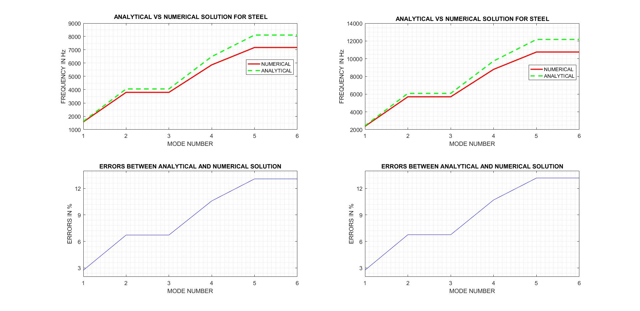

Slide 19
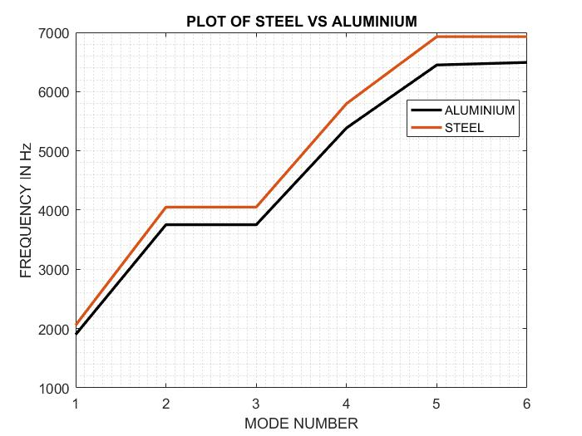

Slide 20
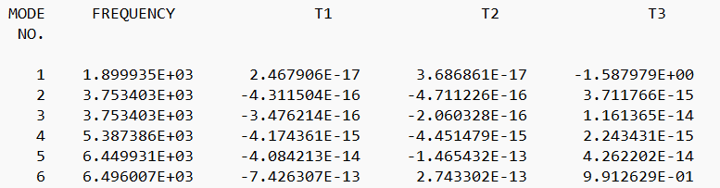
MODAL PARTICIPATION FACTOR
Fig 8: shows Modal participation factor of fixed square plate. T1, T2, T3 are Translation D.O.F in x, y and z directions.

Slide 21
0-2000 Hz
FREQUENCY
0-33 Hz
0-500 Hz
0-1000 Hz
Notes:
21

Slide 22

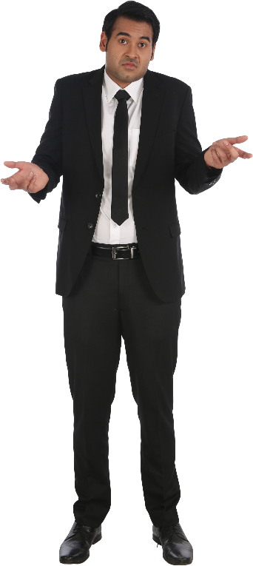
Steel or Aluminium
Which plate to choose?
Steel plate is heavy lets use modified Al sheet

Slide 23
Table of frequency for aluminium Plate before and after Modification
Mode | Aluminium plate | Modified aluminium plate
1 | 1899.93 | 2161.44
2 | 3753.4 | 2888.89
3 | 3753.4 | 4588.13
4 | 5387.39 | 4824.33
5 | 6449.93 | 5238.39
6 | 6493.01 | 5296.47

Slide 24
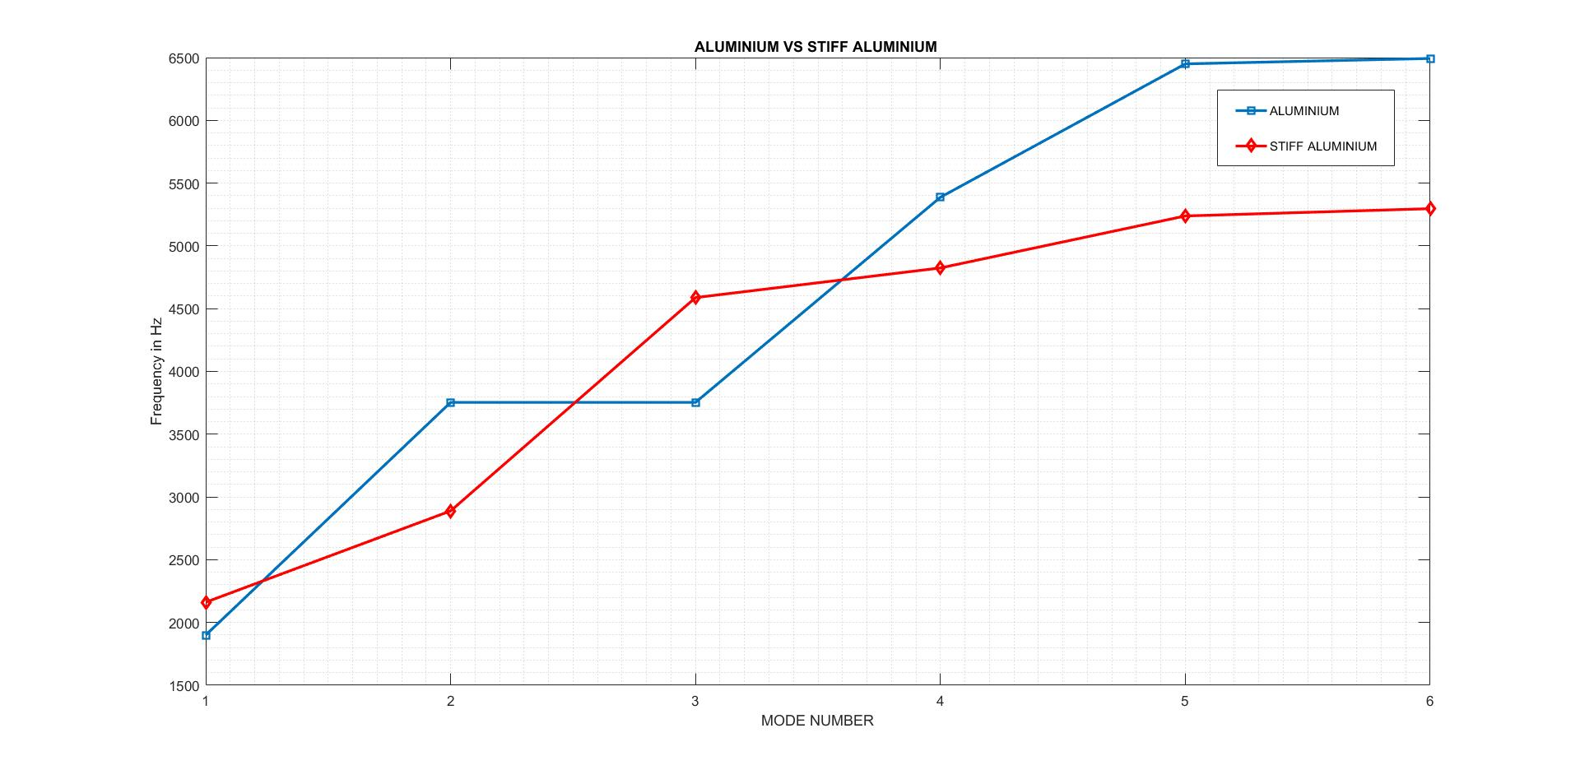

Slide 25

Why do we use this stiffner then?
mass of plate is anyways increasing
The addition of three stiffener has increase the mass of system from 5.03 kg to 10.1 kg but is still less than 15.50 kg steel and is acceptable
Amount of Material and Cost Saved
Cost is directly proportional to material.
$\left(\frac{15.50−10.1}{15.50}\right)∗100=34.8 \%$
Hence about 35 % of cost is saved by using modified aluminum 2014 instead of steel.

Slide 26
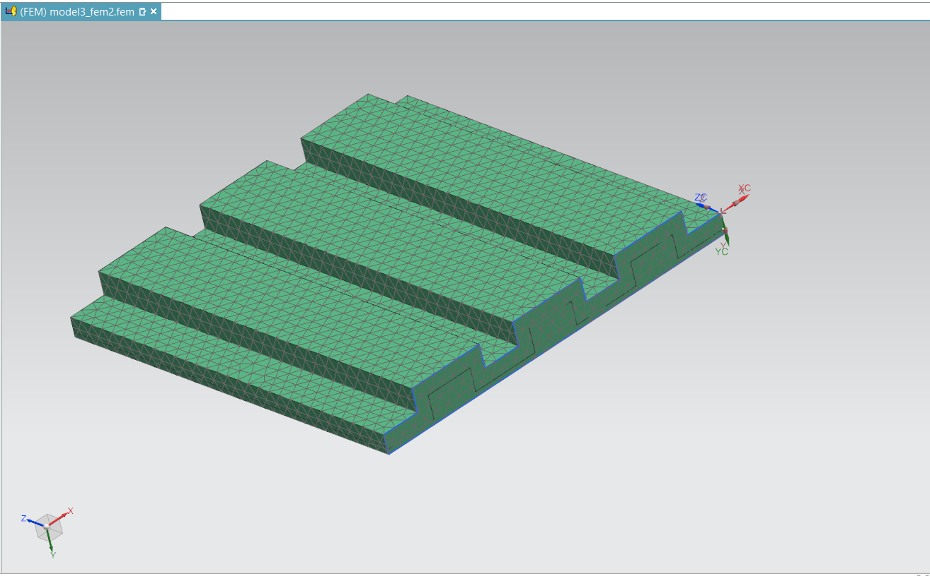
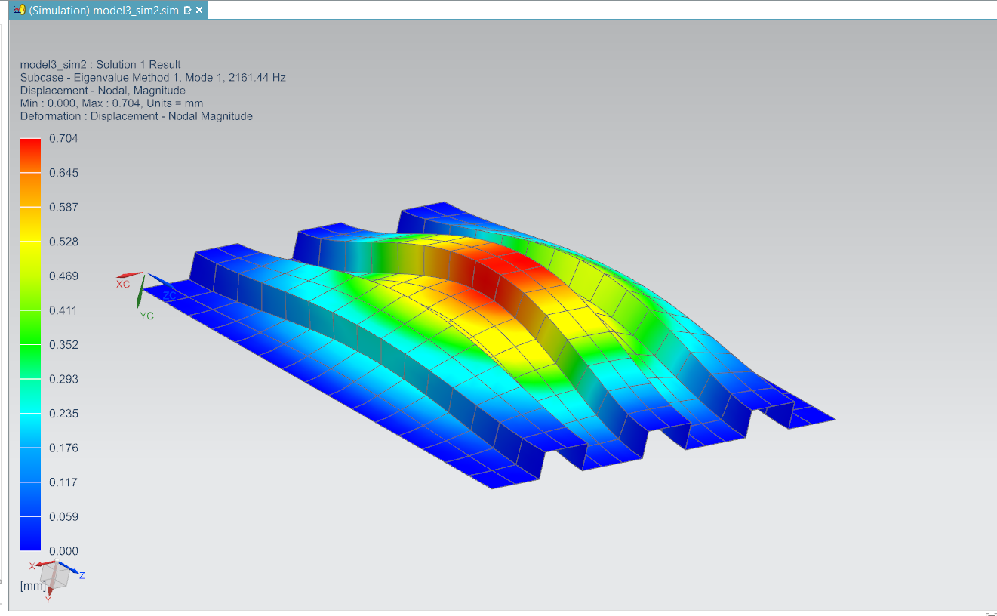
Modified plate with 3 stiffner
Fig 9: Meshed modal of the Al plate with 3 stiffner
Fig 10: first mode shape of the Al plate with 3 stiffner

Slide 27
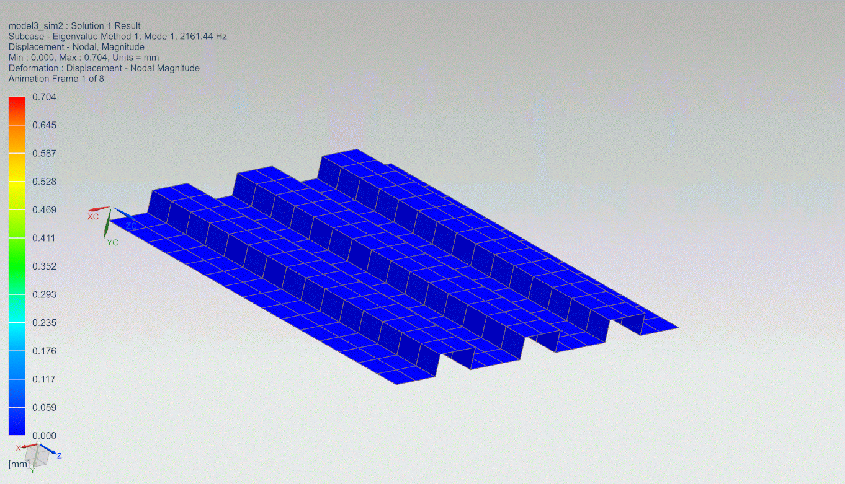
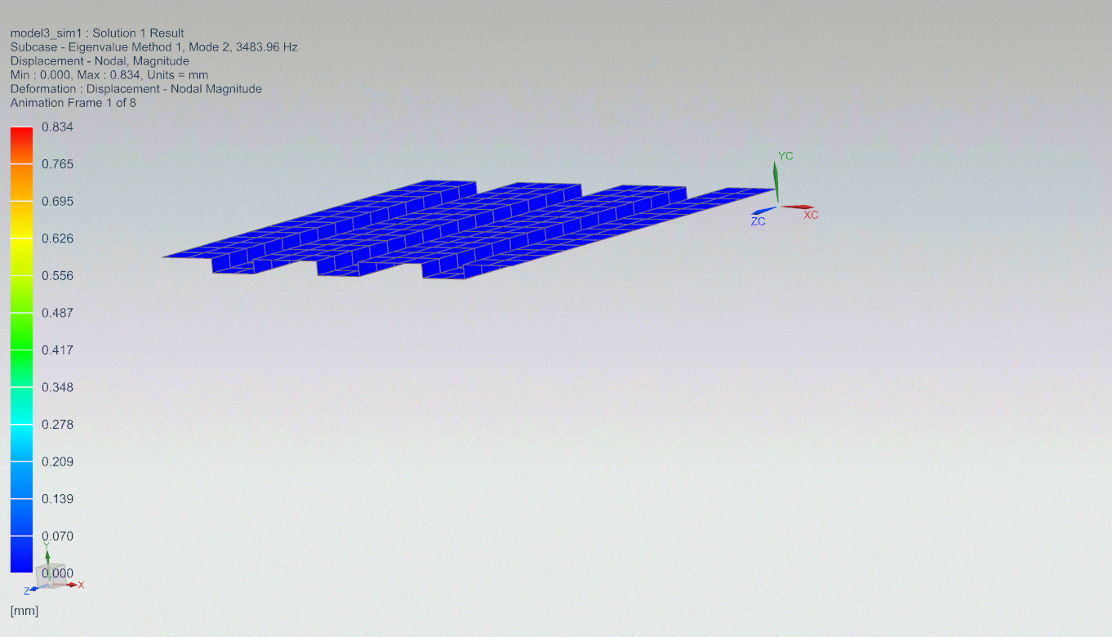
Fig 11: first mode of viberation in NX Nastran
Fig 12: second mode of viberation in NX Nastran

Slide 28
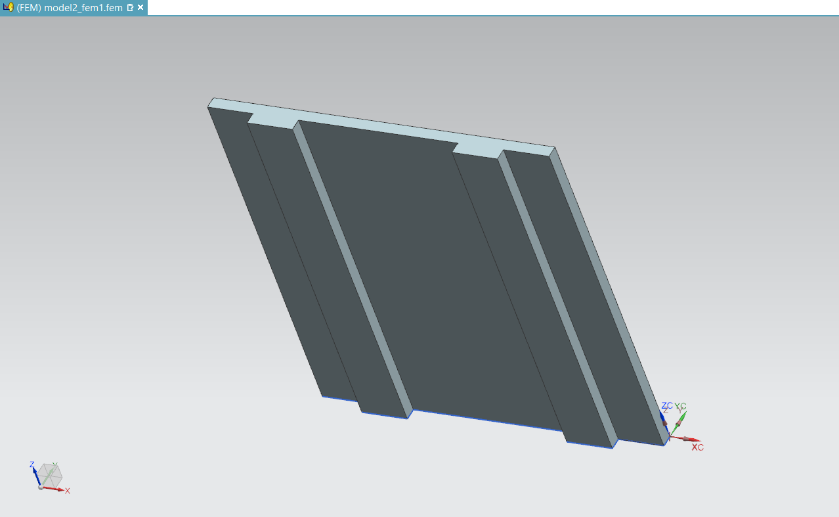
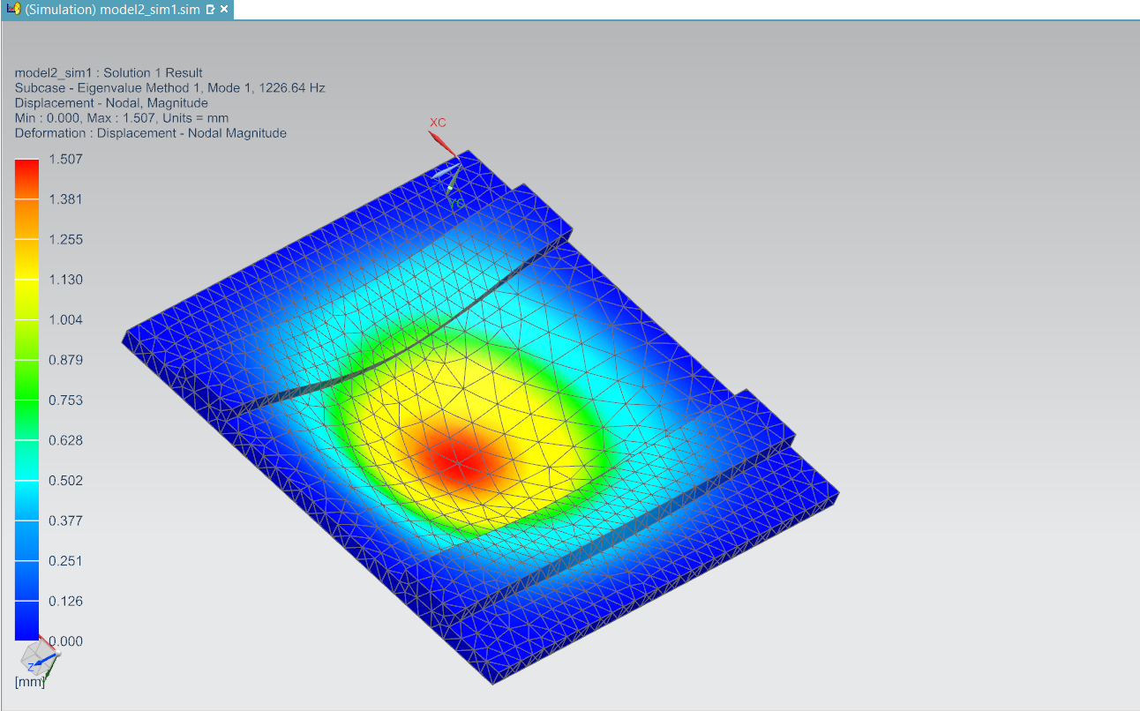
Modified plate with 2 stiffner
Fig 11: CAD model of Al plate with 2 stiffner in NX NASTRAN
Fig 12: first mode of viberation of Al plate with 2 stiffner

Slide 29
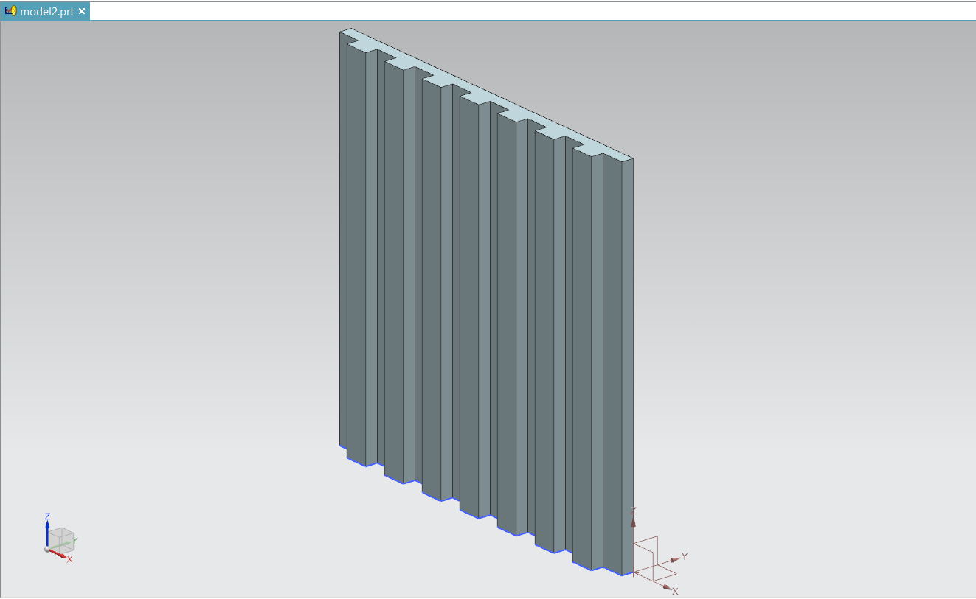
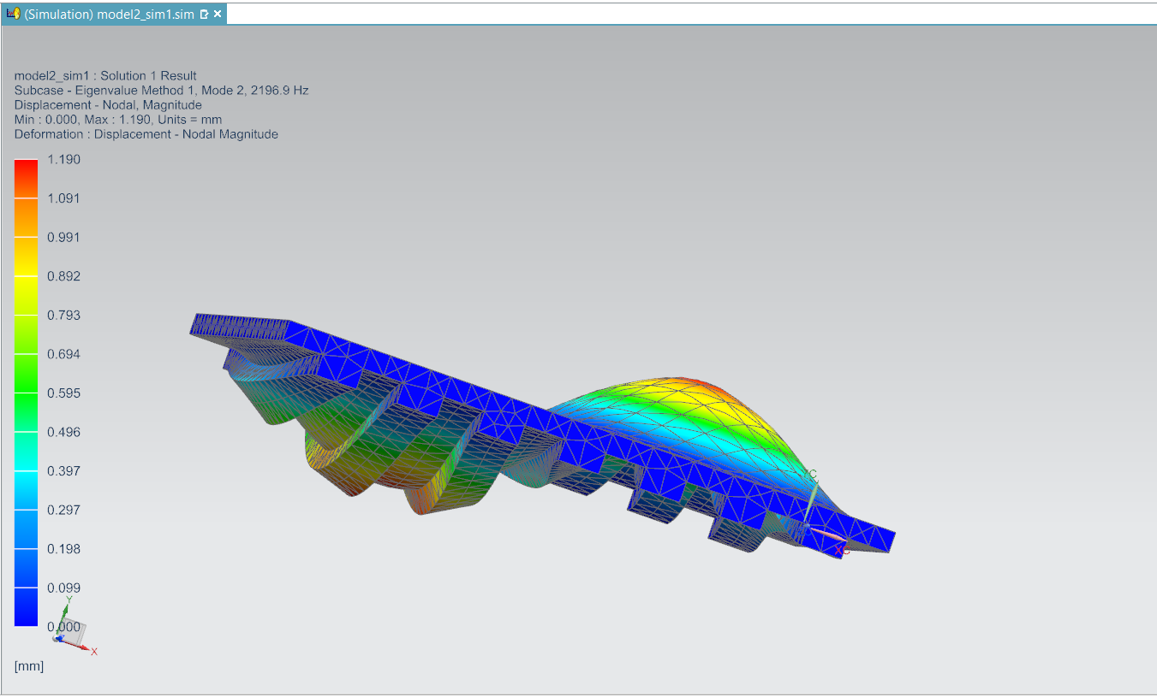
Modified plate with 7 stiffner
Fig 13: CAD model of Al plate with 7 stiffner in NX NASTRAN
Fig 14: second mode of viberation of plate with 7 stiffner

Slide 30
Table of frequencies comparison of aluminium plate with two and seven stiffner
Mode | WITH 2 STIFFNER | WITH 7 STIFFNER
1 | 1226.64 | 1371.99
2 | 2164.48 | 2196.99
3 | 2523.02 | 3174.01
4 | 3646.74 | 3566.34
5 | 3818.12 | 3887.06
6 | 4247.28 | 5122.7

Slide 31
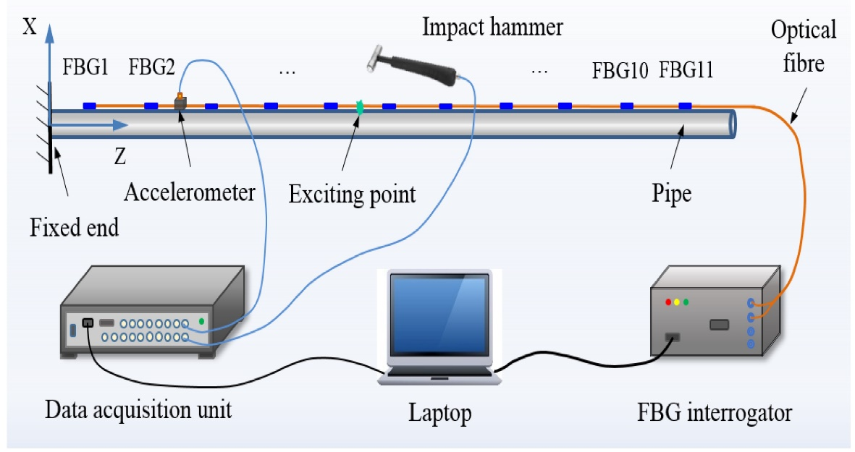
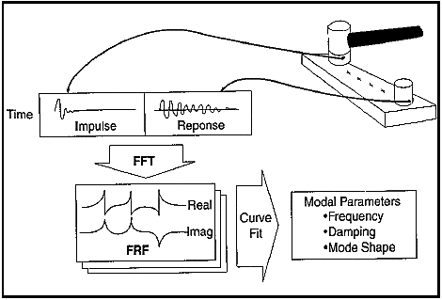
MODAL TESTING USING IMPACT TEST
Modal Impact Testing Can Be Performed By Two Different Approach.
RECIPROCITY THEOREM
ROWING HAMMER
ROWING ACCELEROMETER

Slide 32
CONCLUSION:
ANALYTICAL SOLUTION GIVES MORE VALUES AS COMPARED TO NUMERICAL SOLUTION.
DEVIATION IN FREQUENCY INCREASES AT HIGHER MODES FOR ANALYTICAL APPROACH MAKING IT UNSUITABLE TO USE.
STEEL IS MORE STIFFER THAN ALUMINIUM FOR THE SAME DIMENSIONS.
STIFFNER IS ADDED TO INCREASE THE FREQUENCY OF SYSTEM. DYNAMICALLY ACCEPTED, STATICALLY ?
We covered most of topics present in our curriculum such as
Participation factor and its physical interpretations
Reciprocity theorem and its real world application.
Langrange And Hamilton Principles
Modes Shapes And Its Interpretation.

Slide 33
REFERNCE:
Composite Structures 89 (2009) 567–574, New exact solutions for free vibrations of thin orthotropic rectangular plates Y.F. Xing *, B. LiU.
Exact Solutions for Free-Vibration Analysis of Rectangular Plates Using Bessel Function BY H. L. Chen
Effects of various edge condition on free vibration and its charateristics od isotropic plates by M. Hussain.

Slide 34
THANK YOU

